Slide 1
Project Hardware Specification
Group #8
By: Zain Rajani (c0752681)

Slide 2
Presentation Layout
Project Overview
Main Processing Unit (Beaglebone AI)
Features and Specification
Parts of BB-AI
Light Dependent Resistor Module
Features and Specification
Image of the module
IR Sensor Module
Features and Specification
Image of the module
GSM Module
Features and Specification
Image Module

Slide 3
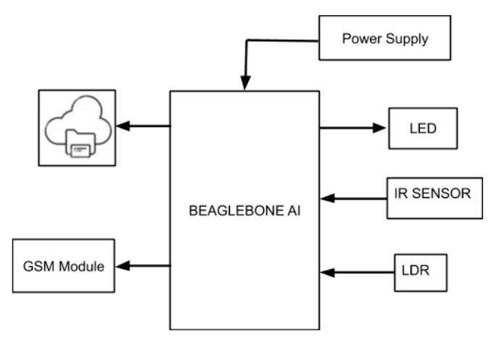
PROJECT OVERVIEW
The project is used to improvise the conventional letter box system. It uses various peripherals and sensors for this purpose
The letter box senses the number of letters and counts them along with each arrival it sends the message to the user and also when the letter is removed the count of this letter goes to zero along with a notification
The information of the arrival time along with the date is stored in the cloud

Slide 4
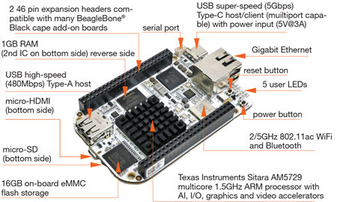
BEAGLEBONE AI

Slide 5
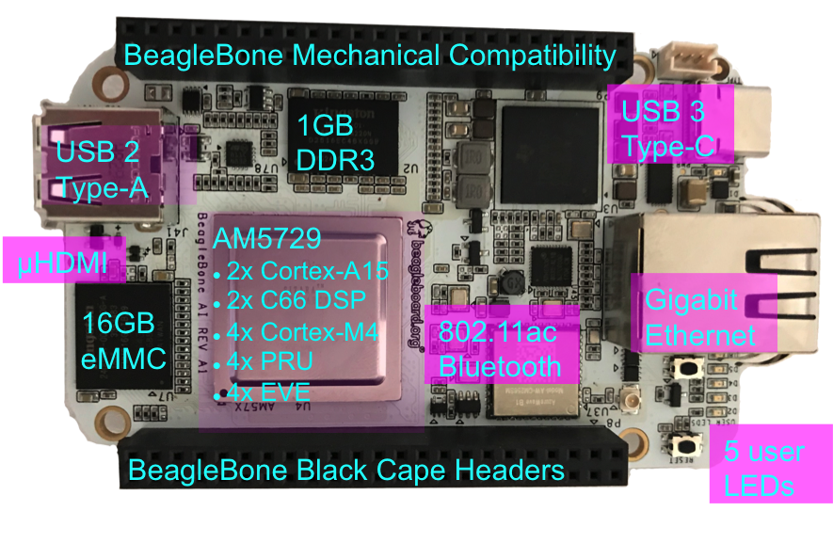
BB-AI (BEAGLEBONE ARTIFICIAL INTELLIGENCE)
Dual ARM Cortex-A15 processor which is much faster than existing BeagleBone Black
Memory: 1 GB RAM and 16 GB on-board eMMC Flash
BeagleBone® AI comes in a similar form-fact as BeagleBone® Black and compatible with many BeagleBone® Cape add-on boards make it easy to extend the functionality.
Has in-built Wifi supporting 802.11ac via AzureWave AW-CM256SM supports dual band of 2.4 GHz and 5 GHz
Type-C (host/ client- superspeed) and Type- A USB host

Slide 6
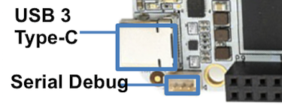
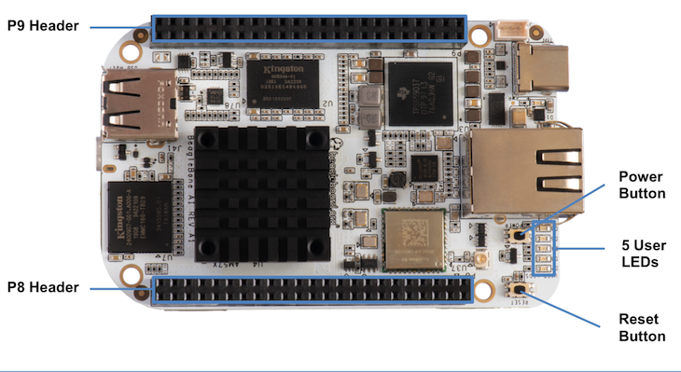
BB-AI (BEAGLEBONE ARTIFICIAL INTELLIGENCE)
2 x 46 expansion header which includes 4+ UARTSs, 2 I2C, 2 SPI and lots of PRU and I/O pins
3- pin serial Debug
Power by 5 V Adapter with working voltage of 3.3 V
5 User LEDs which are connected to the GPIO and indicate various functions like HeartBeat when Linux is Running, microSD Activity, CPU Activity, eMMC Activity, Wifi/Bluetooth Activity

Slide 7
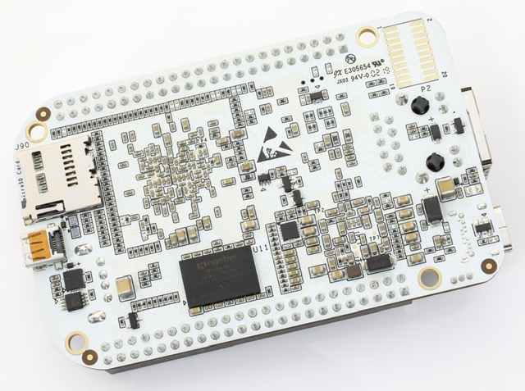
BB-AI (BEAGLEBONE ARTIFICIAL INTELLIGENCE)
Consists of Pre-attached Heatsinks
Supports Bluetooth with 1 antenna to support Transmit and Receive
Bluetooth Version: 4.2. Supports data rate of 2Mbps and 3Mbps
MicroSD Card slot along with support for HDMI
More revision to the hardware are awaited and thus it is a choice for our main processing unit in the project

Slide 8
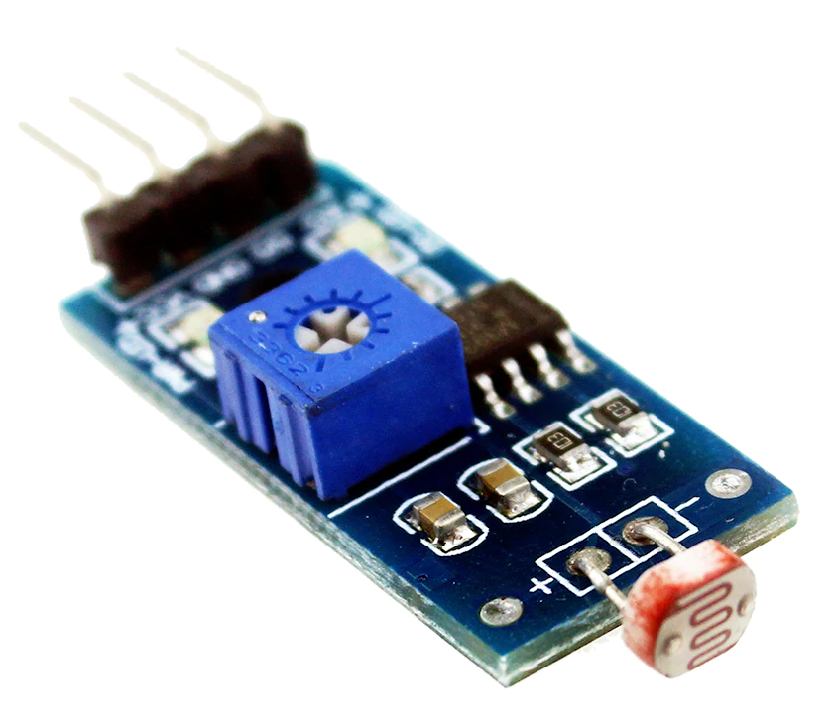
LDR (LIGHT DEPENDENT RESISTOR)

Slide 9
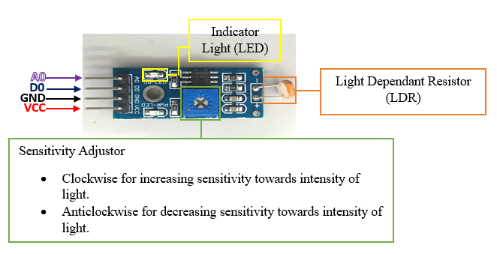
Light Dependent Resistor (LDR)
Can be used to sense light
Small, cheap and easily available
Operating Voltage: 3.3 V to 5 V DC
Operating Current: 15 mA
Output: Digital (Adjustable trigger level from preset) and Analog (Based on light falling on the LDR)
LM393 based design and works on the principle of photoconductivity
It shall be connected to the main processing unit to detect the intensity of light and thus help in resetting the count for the letters

Slide 10
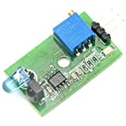
IR (INFRARED) SENSOR

Slide 11
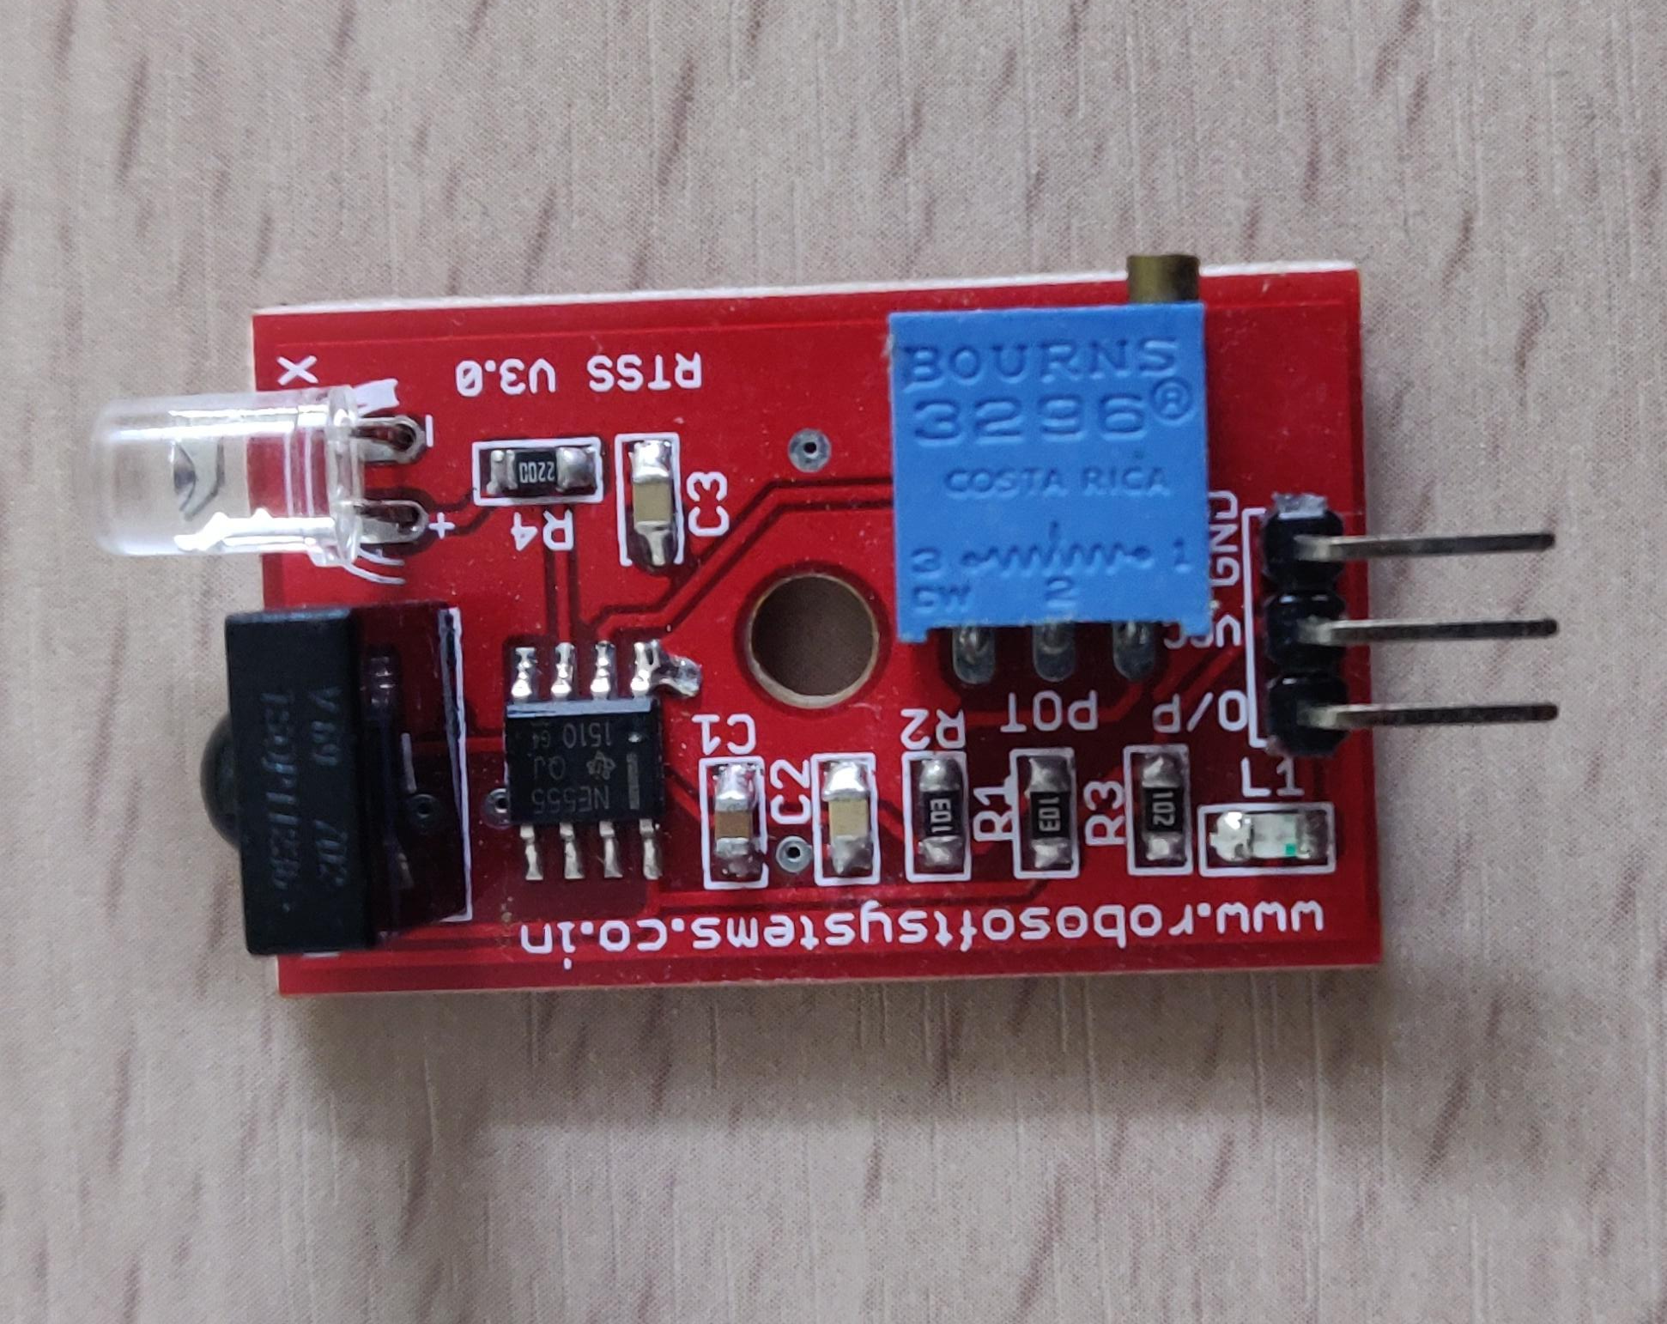
IR SENSOR
Operating Voltage: 5V
I/O pins are 5V and 3.3 V compliant
Range: Upto 20 cm
Adjustable sensing range through the Pot
Digital Output with low power consumption
This sensor will be used to check for the arrival in the letter box
Alternative for this sensor would be TCRT5000 which uses LM393 based design

Slide 12
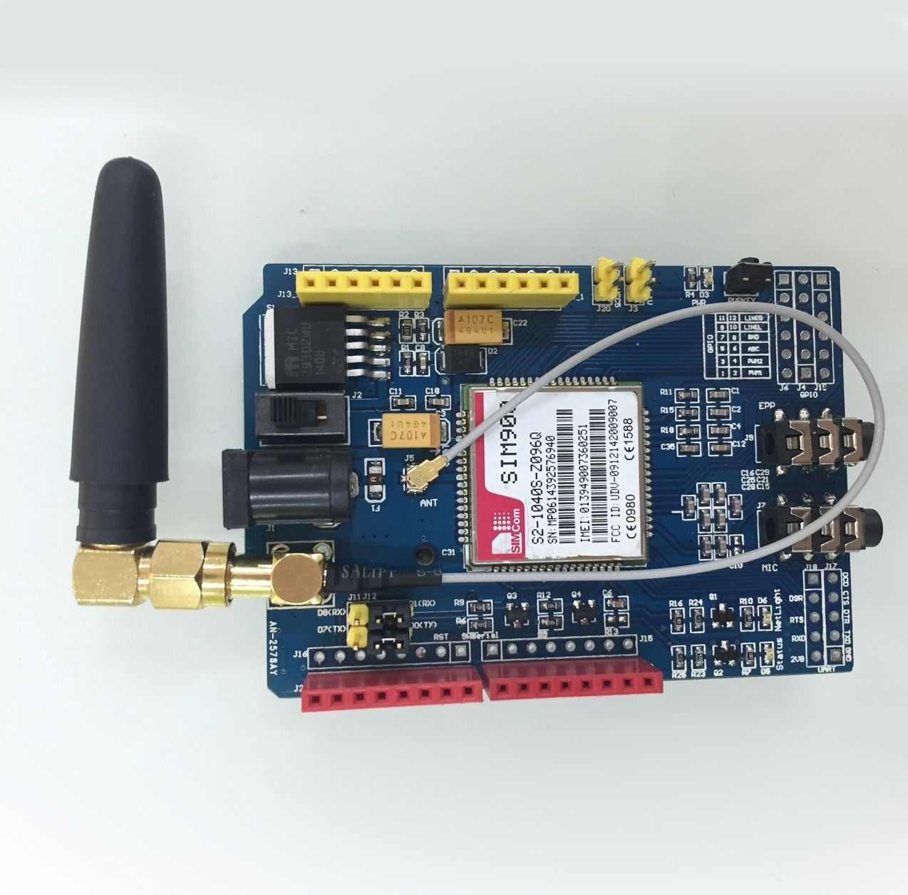
GSM MODULE SIM900 SHIELD

Slide 13
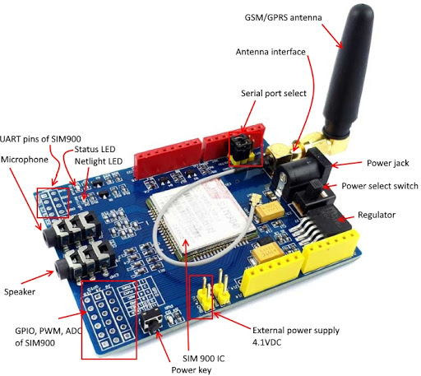
GSM MODULE SIM900 SHIELD
Quad-Band 850/ 900/ 1800/ 1900 MHz would work on GSM networks in all countries around the world
Supports RTC through the battery support for 3V CR 1220 at the back
Supply Voltage ranging from 3.4 V to 4.5 V and Low Power Consumption
This module is used to send SMS (Short Service Message to the user when any letter arrives)
The SMS is sent via the AT Commands

Slide 14
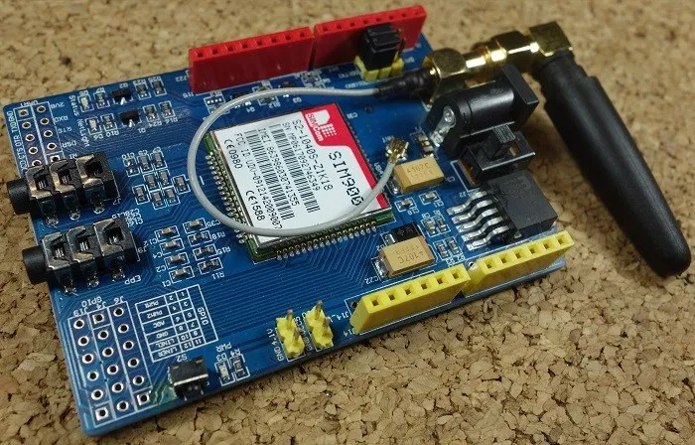
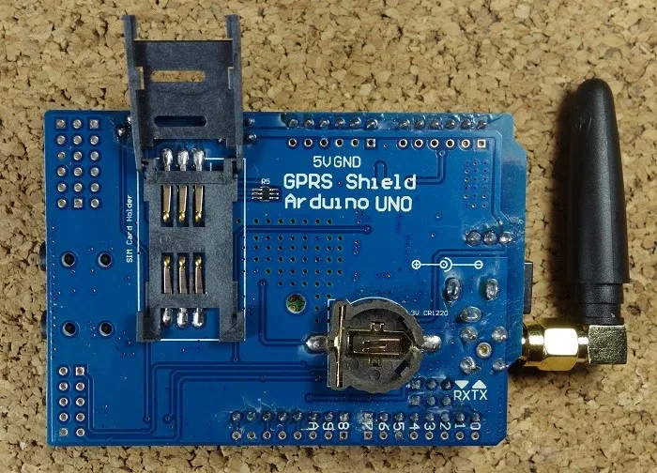
GSM MODULE SIM900 IMAGES
FRONT VIEW
BACK VIEW

Slide 15
References
Beagleboard. (n.d.). Beagleboard/beaglebone-ai. Retrieved October 12, 2020, from https://github.com/beagleboard/beaglebone-ai/wiki/System-Reference-Manual
LM393 IC : Pin Configuration, Circuit Diagram & Its Working. (2020, May 27). Retrieved October 12, 2020, from https://www.elprocus.com/lm393-ic-pin-configuration-circuit-diagram-and-its-working/
Light Sensing Module - LDR. (n.d.). Retrieved October 12, 2020, from https://www.sunrom.com/p/light-sensing-module-ldr

Slide 16
References
GSM/GPRS Shield Datasheet. (n.d.). Retrieved October 12, 2020, from https://www.tinyosshop.com/datasheet/GSM%20Shield%20Datasheet.pdf
SIM900 GSM GPRS Shield with Arduino. (2019, April 02). Retrieved October 12, 2020, from https://randomnerdtutorials.com/sim900-gsm-gprs-shield-arduino/
(n.d.). Retrieved October 12, 2020, from https://www.openimpulse.com/blog/products-page/product-category/tcrt5000-infrared-sensor-module/
IR Sensor Based obstacle detection sensor module (Single). (n.d.). Retrieved October 12, 2020, from https://cdn.instructables.com/ORIG/FW9/SBS0/J3EPQTB8/FW9SBS0J3EPQTB8.pdf

